Slide 1
What did I have my hands in at Rand McNally?
Watch and see!

Slide 2
The Deets
At Rand McNally I worked closely with a variety of cross-functional teams on just about everything having to do with our commercial transportation/mobile communications business.
The following presentation provides a quick snapshot of the range of projects I managed and contributed to. From marketing collateral and customer support materials, to advertising, email, product launches, trade shows and more, there was always a lot going on!
Involvement includes:
Marketing Strategy & Project Management
Copywriting, Content Management, Creative Direction & Product Messaging
Branding & Product Launches
Please note that the materials included were not DESIGNED by me, and contribution varies by project.

Slide 3
Print Advertising: Trucking

Slide 4
Print & Radio Advertising: Trucking
The Dave Nemo Show

Slide 5
Print & Online Advertising: Fleet Management

Slide 6
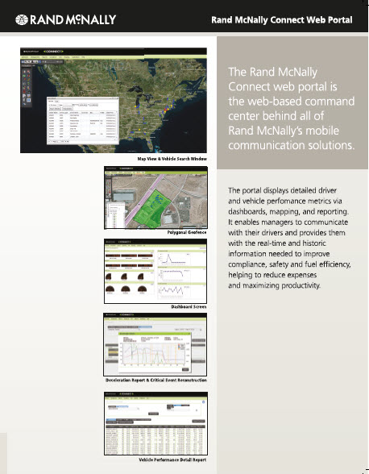
Collateral: Inside & Outside Sales + Trade Shows

Slide 7
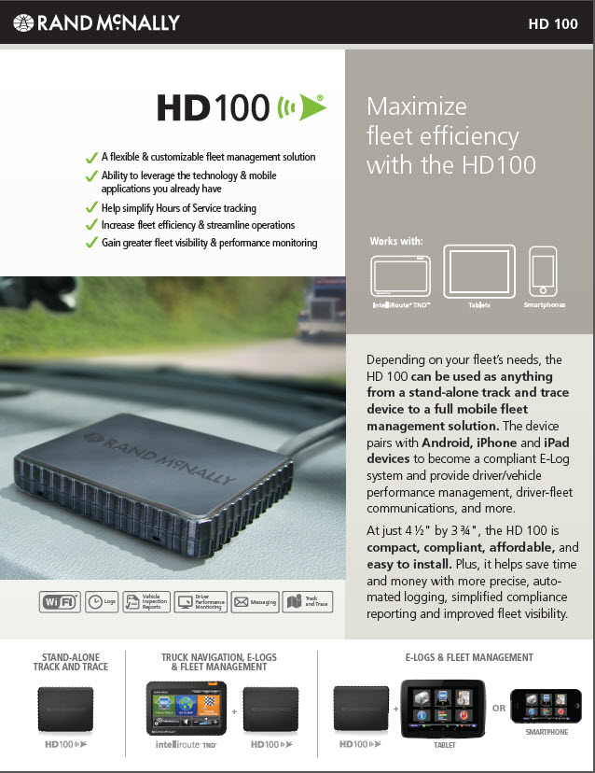
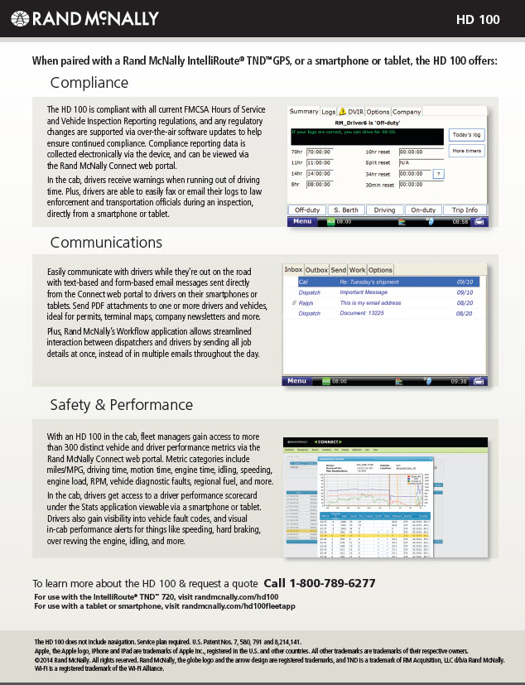
Collateral: Inside & Outside Sales + Trade Shows

Slide 8
Collateral: Inside & Outside Sales + Trade Shows

Slide 9
Collateral: Inside Sales & Trade Shows

Slide 10
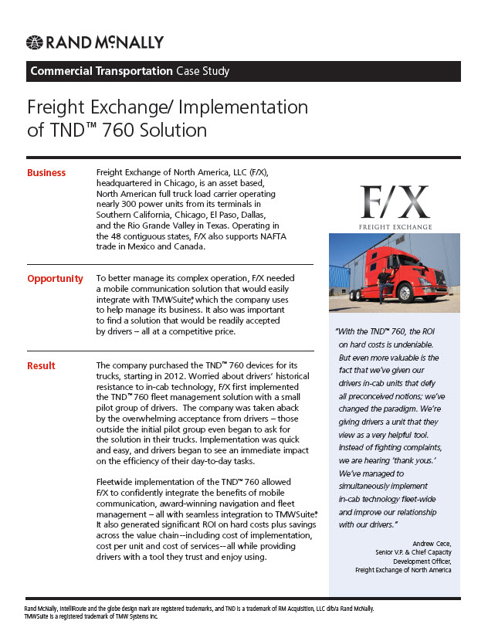
Collateral: Inside Sales & Trade Shows

Slide 11
Collateral: Retail POP

Slide 12
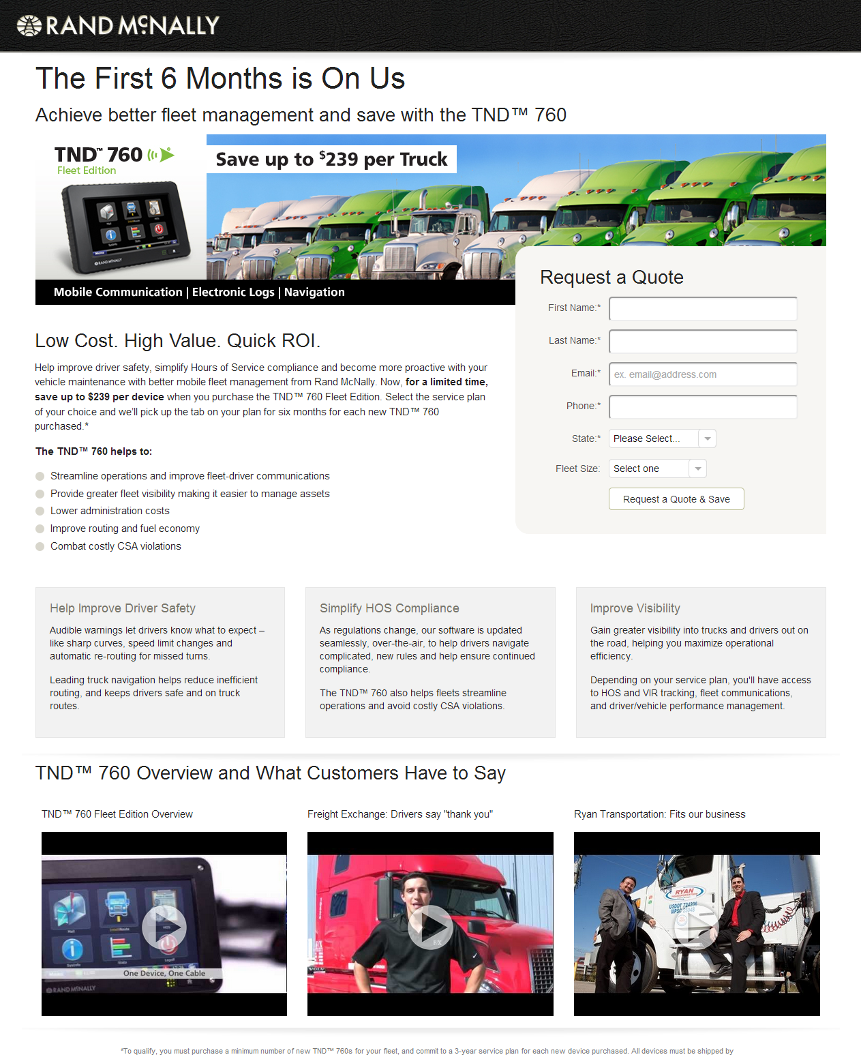
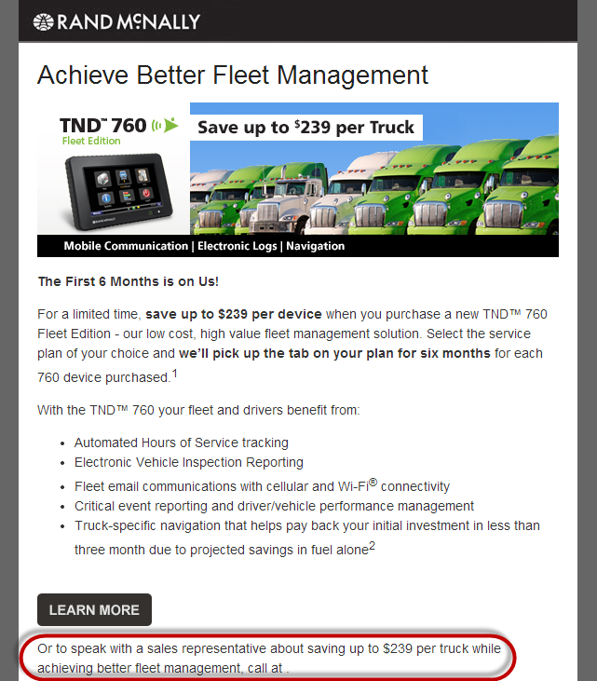
Emails: Promotional
21.7% Open Rate
3.26% Click Rate

Slide 13
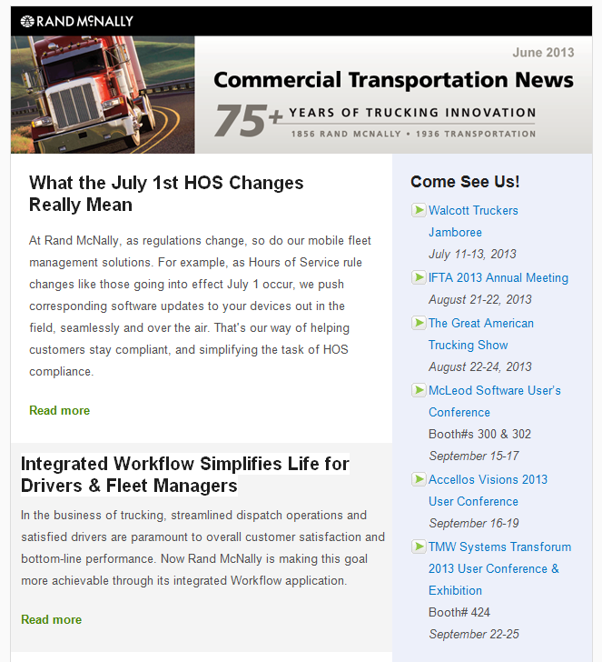
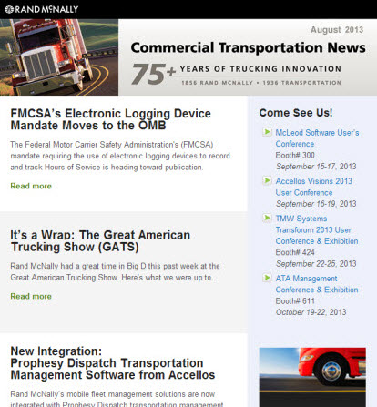
Email: Newsletters
Commercial Transportation News
Average Open Rate: 20%

Slide 14
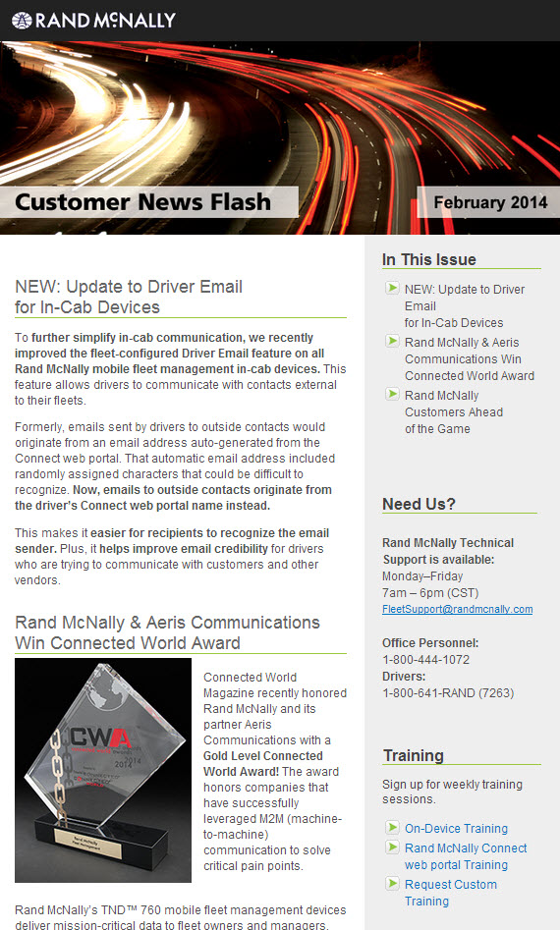
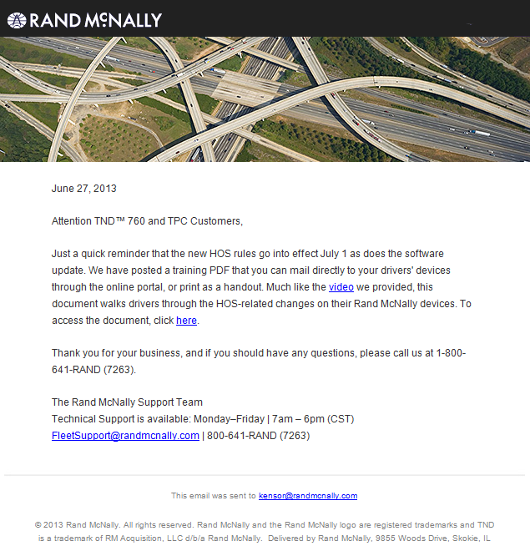
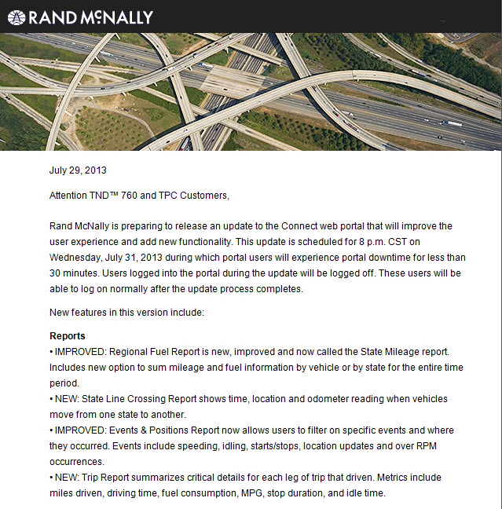
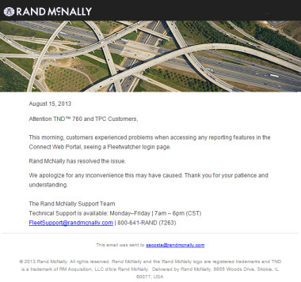
Email: Newsletters & Updates
Customer News Flash
Average Open Rate: 30%
Customer Notifications

Slide 15
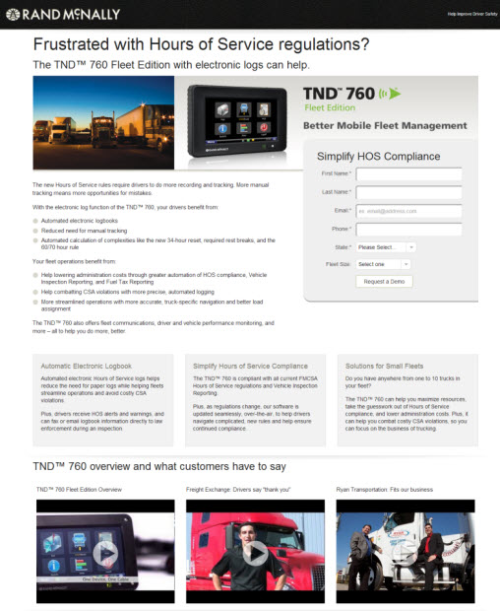
Web/Landing Pages
Click the image
for the full page!

Slide 16
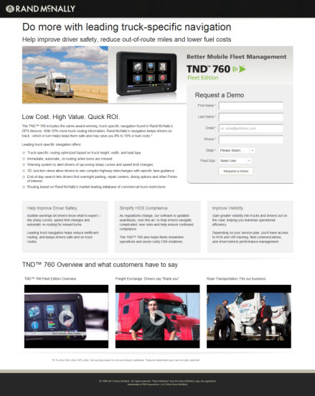
Web/Landing Pages
Click the image
for the full page!

Slide 17
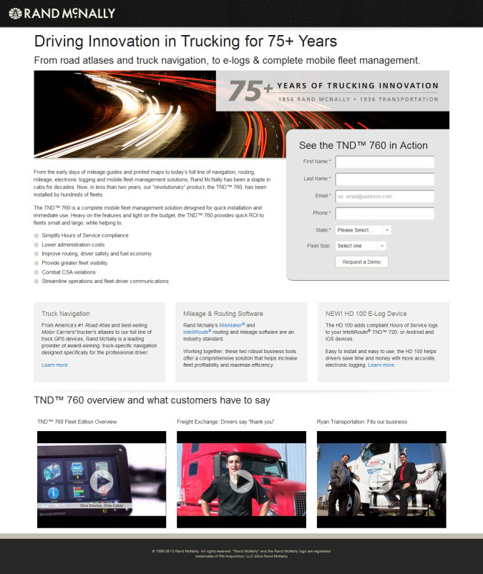
Web/Landing Pages
Click the image
for the full page!

Slide 18
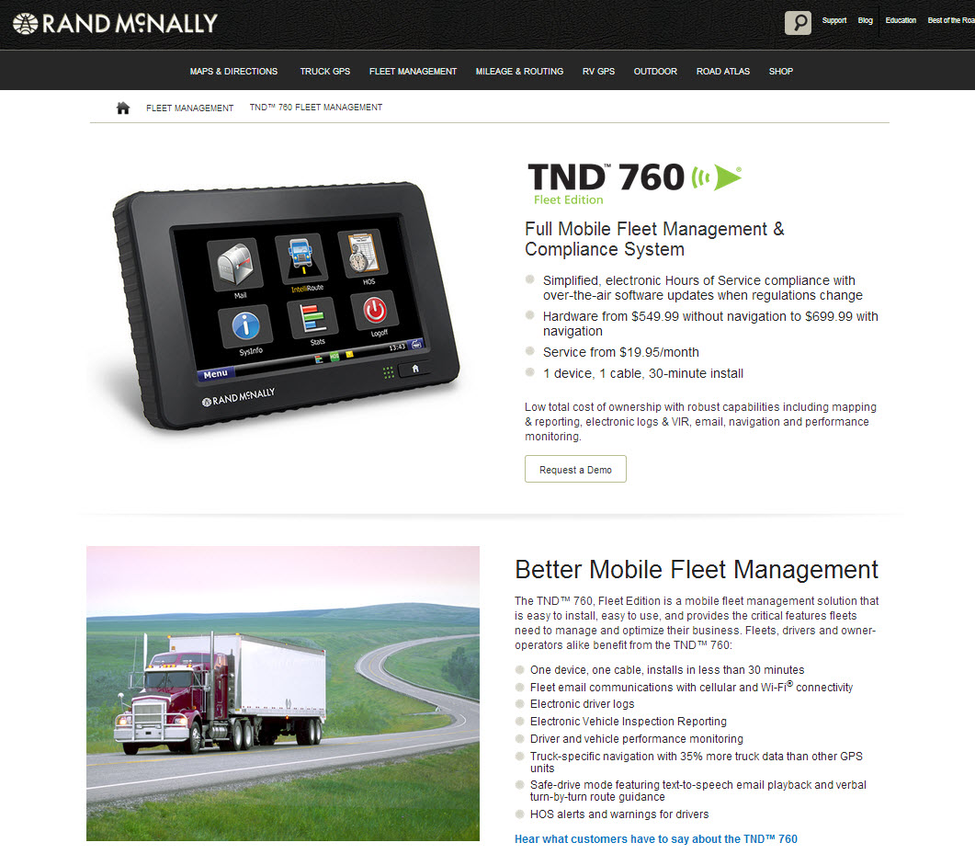
Web/Product Pages
Click the image
for the full page!

Slide 19
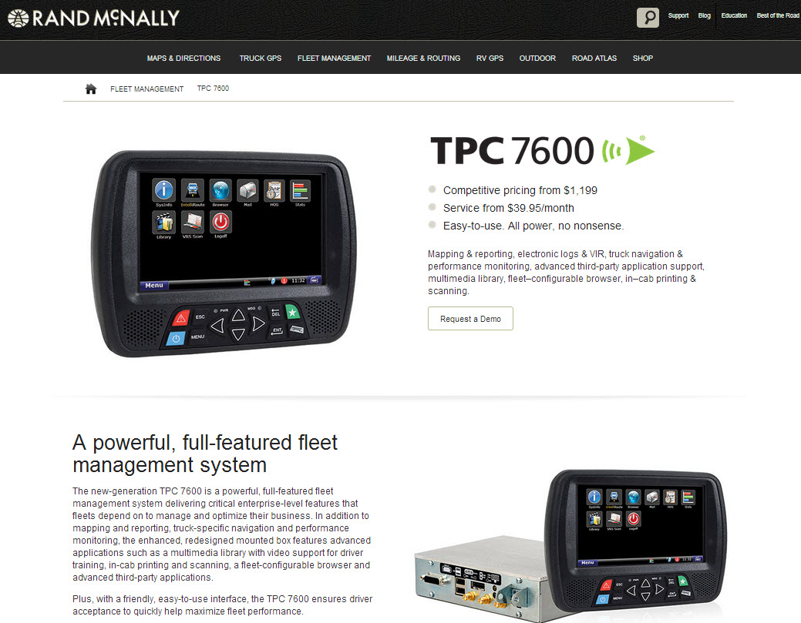
Web/Product Pages
Click the image
for the full page!

Slide 20
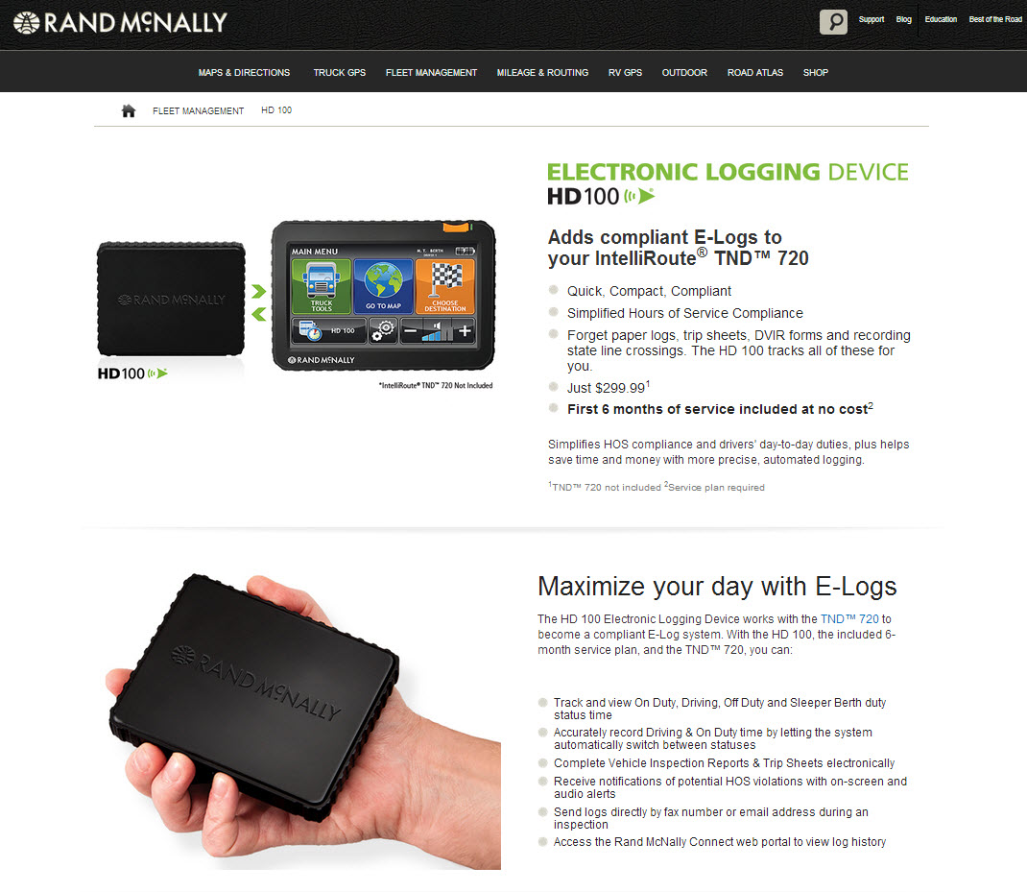
Web/Product Pages
HD 100 at Retail/B2C: Drivers, Owner Operators & Small Fleets
Click the image
for the full page!

Slide 21
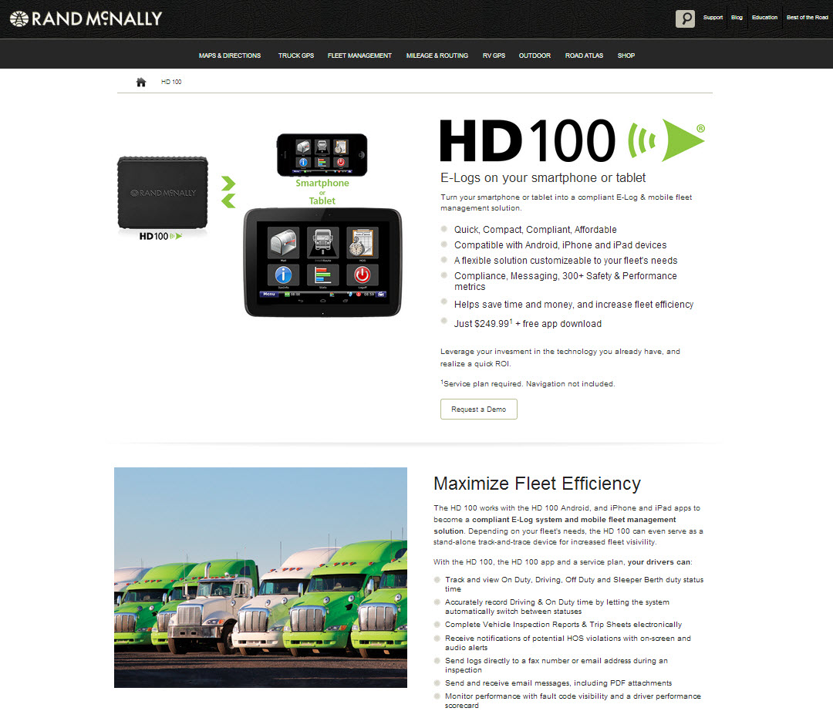
Web/Product Pages
HD 100 for Medium to Large Fleets/B2B
Click the image
for the full page!

Slide 22
Video Scripting: Retail POP Kiosk

Slide 23
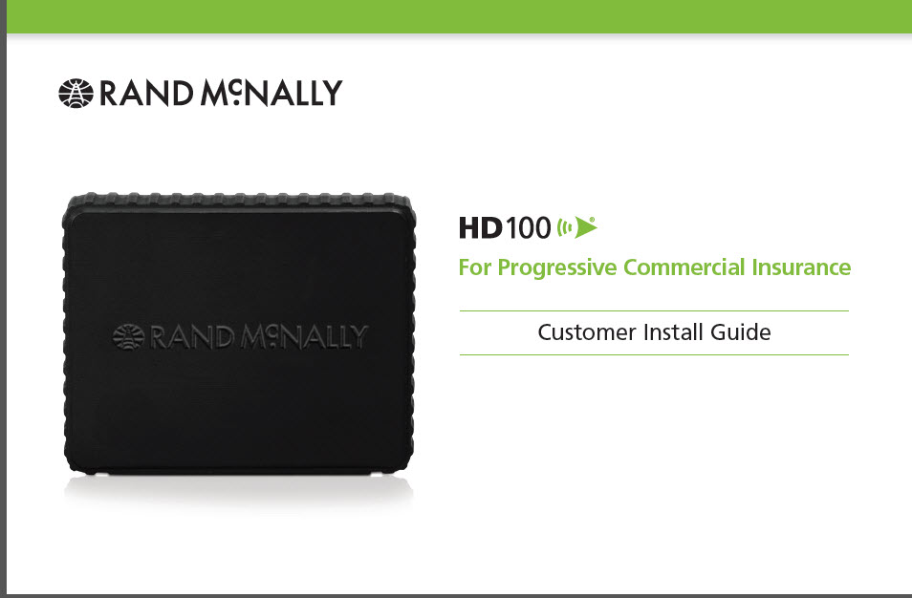
User Documentation

Slide 24
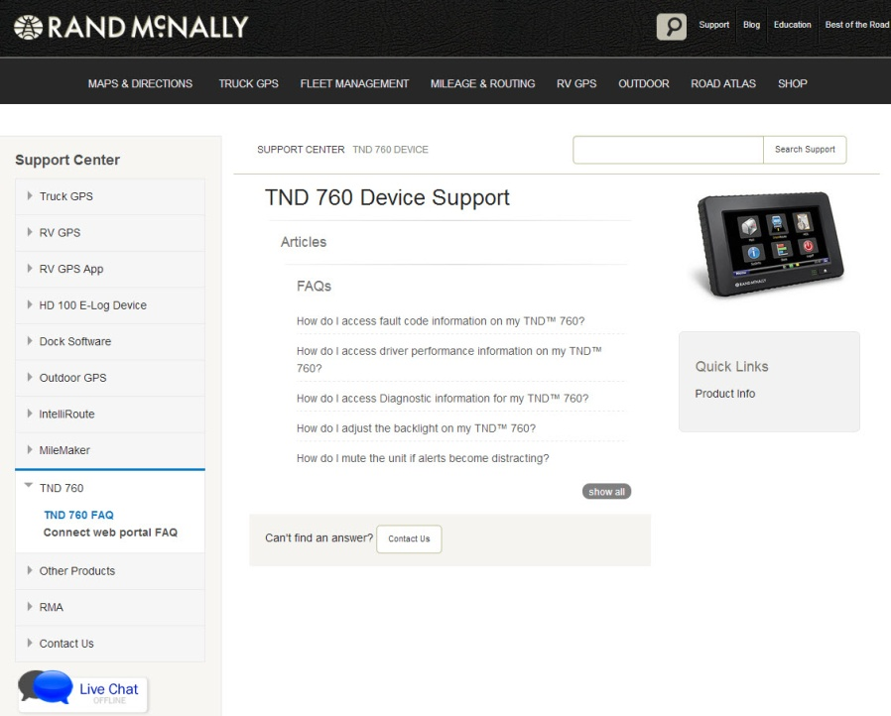
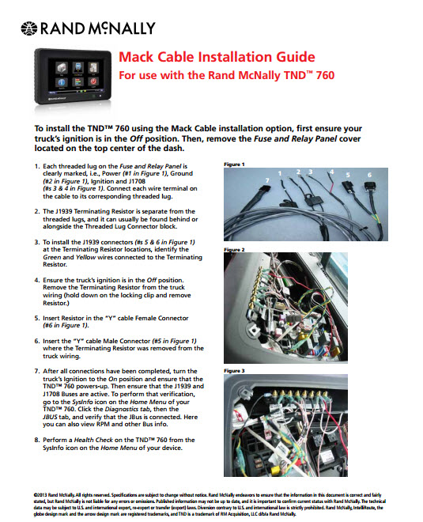
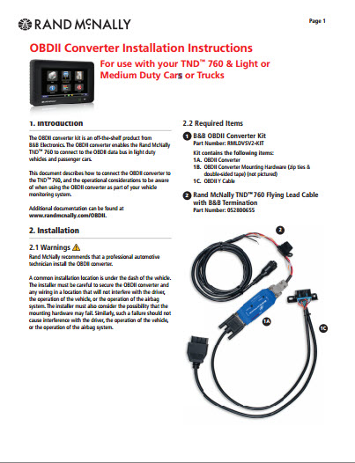
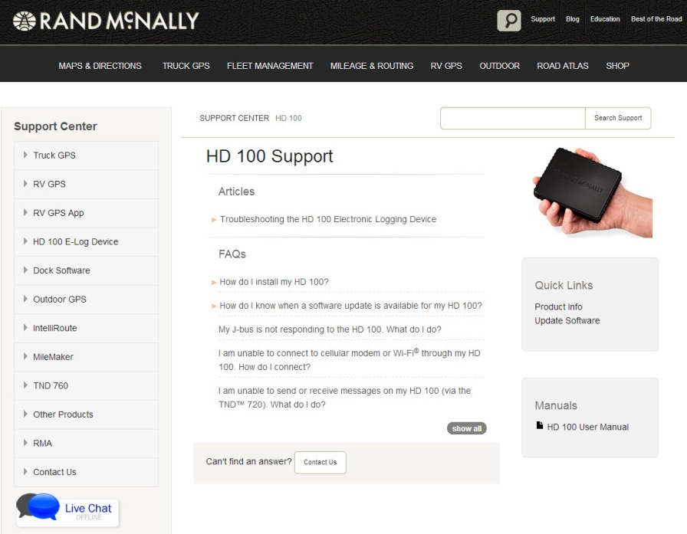
Customer Support
Click the image for the full page!

Slide 25
Thanks for tuning in!

